Slide 1
Tech for Parents Module 3
The Internet

Slide 2
Agenda
Review Surfing the Net
Explore School Homepage
Internet Terms
SUSD Website Continued
Review
Questions
Materials Needed:
- Wi-Fi Enabled Device
- Pencil / Pen
- Paper

Slide 3
Internet Basics the Google Browser
Tabs Bar
URL/Web Address Bar; Browser
Minimize
Maximize
Exit
Google Search Bar; Browser

Slide 4
School Locator

Slide 5
INTERNET TERMS
Please take some time to make your own chart at home for our next activity.

Slide 6
INTERNET TERMS
Cookies
Download
Firewall
Hyperlink
Upload
URL/Web Address
Website/Webpage

Slide 7
INTERNET TERMS
From the list, fill in the table with familiar internet terms you may already know; and those you don’t.

Slide 8
INTERNET TERMS
Cookies
Download
Firewall
Hyperlink
Upload
URL/Web Address
Website/Webpage

Slide 9
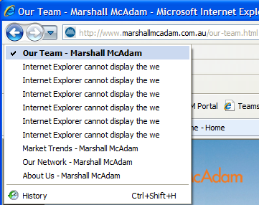
INTERNET TERMS
Cookies ~ Online files that track your browsing history and information for later use. Remember, new ‘accepting’ law.

Slide 10
Download ~ Saving information, data, movies, pictures, or programs to a phone, laptop, or computer device
Upload ~ Saving information, data, movies, pictures, or programs to the internet from a personal device

Slide 11
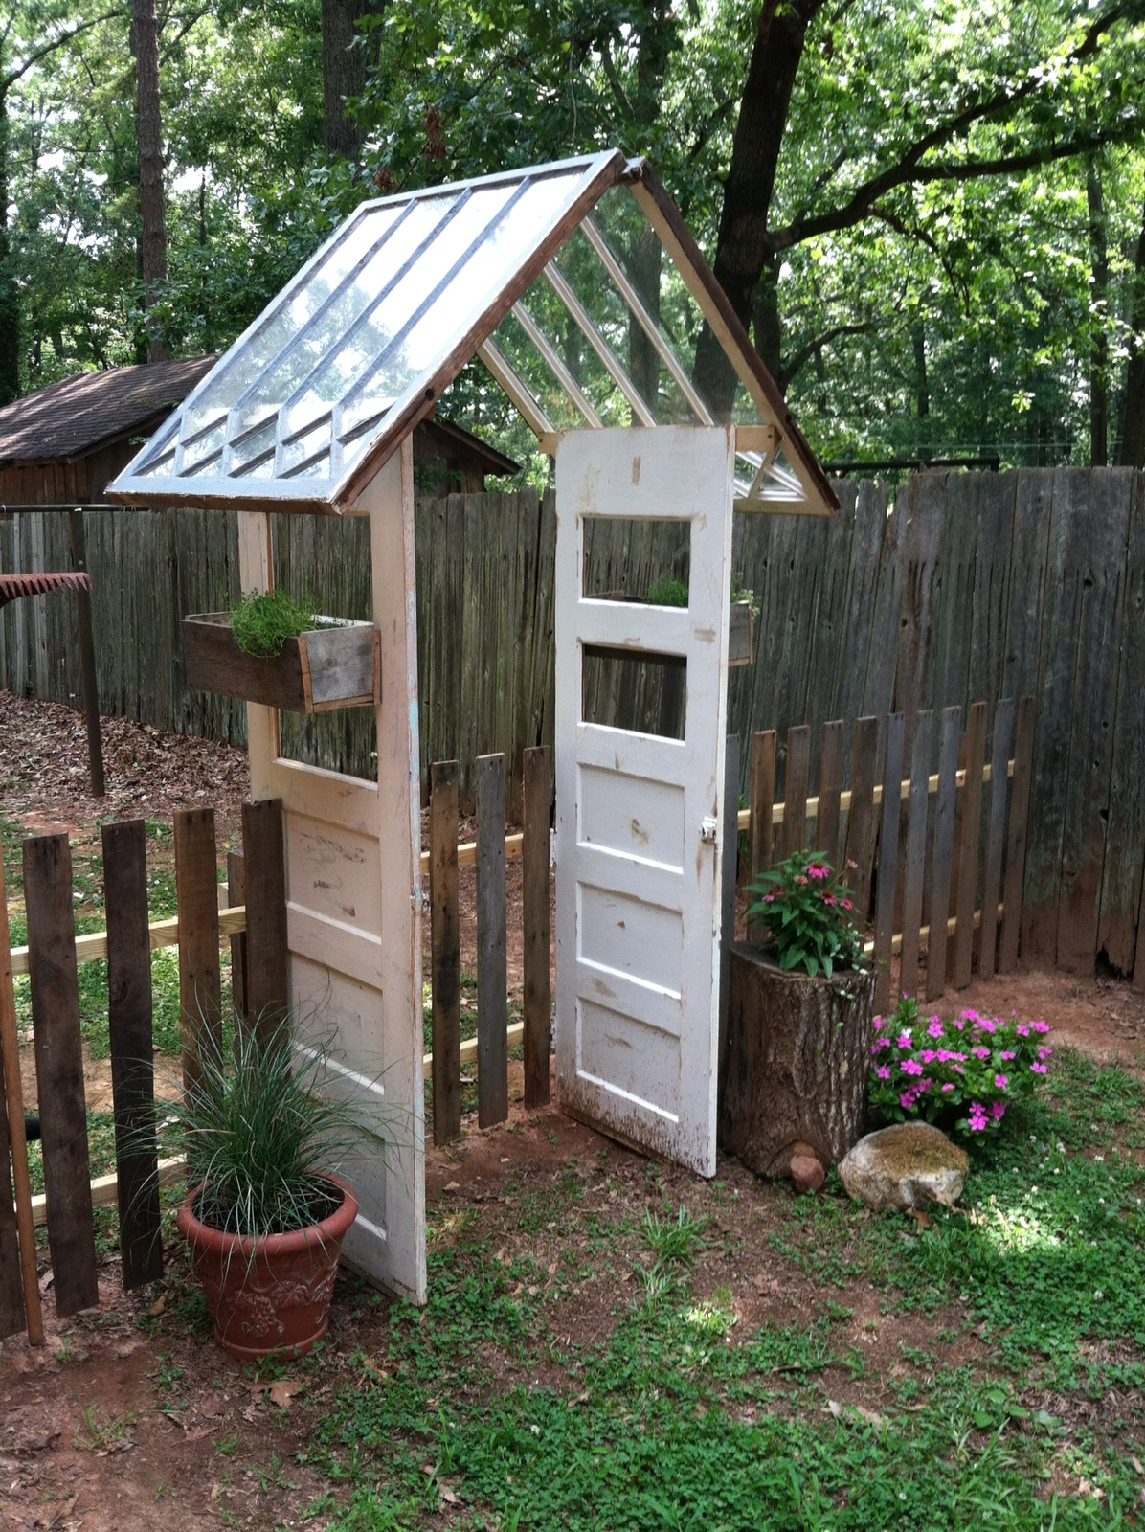
VS.
Firewall ~ A computer program that protects against viruses, spam, Trojans, and hackers

Slide 12
Hyperlink ~ A clickable link (digital button) that takes you to another part of the website
Family Engagement & Education: www.stocktonusd.net/feeo

Slide 13
URL/Web Address ~ The “address” used to reach a specific website. All are unique (like a street address)
Website/Webpage ~ A page on the internet that houses information, games, movies, pictures, and anything accessible on the internet

Slide 14
Internet SUSD Website continued
Online Demonstration
Follow along on your screens to see your presenter surf the internet and help identify different sites, tools, and uses.
Please feel free to ask any questions about anything you see on screen or have heard and would like to hear more about.

Slide 15
Review
Reviewed Google Search Engine
Visited their school’s webpage
Accessing SUSD Departments, Student QuickLinks
Learned internet terms

Slide 16
Questions

Slide 17
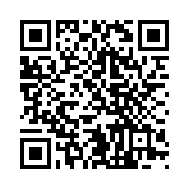
Survey
Please take a few minutes to fill out the presentation survey. The surveys help improve future presentations and events.
Thank You!
-Family Engagement & Education

