Slide 1
Tech for Parents Module 1
Computer basics

Slide 2
Agenda
Computer Basics
Desktops and Chromebooks
Chromebook Keyboard
Trackpad/ Mouse
Materials Needed:
- Wi-Fi Enabled Device
- Pencil / Pen
- Paper

Slide 3
Computer Basics Parts of a Computer
.
(1) Computer Tower
(2) Disk Drive (CDs/DVDs)
(5) Power Button
(7) USB Port
(4) Mouse
(8) Webcam
(6) Screen/Monitor
(3) Keyboard

Slide 4
Computer Basics Parts of a Laptop
(4) Screen
(5) Start Button
(1) ESC Key
(3) Power Button
(6) [Track/Mouse] Pad
(2) [Left/Right] Clicker

Slide 5
Computer Basics Parts of a Laptop

Slide 6
the CHROMEBOOK keyboard The KEYS on the KEYBOARD You Must Know
Power On/Off
ESC
Back & Forward
Refresh
Full Screen
Switch Between Screens

Slide 7
Hands on Exploring the keyboard The KEYS on the KEYBOARD You Must Know
Dimmer
Brighter
Mute
Volume
Search
Backspace
Enter
Shift
Spacebar

Slide 8
the CHROMEBOOK keyboard The KEYS on the KEYBOARD You Must Know
ESC back forward refresh full screen switch bet dimmer brighter mute vol down vol up power

Slide 9
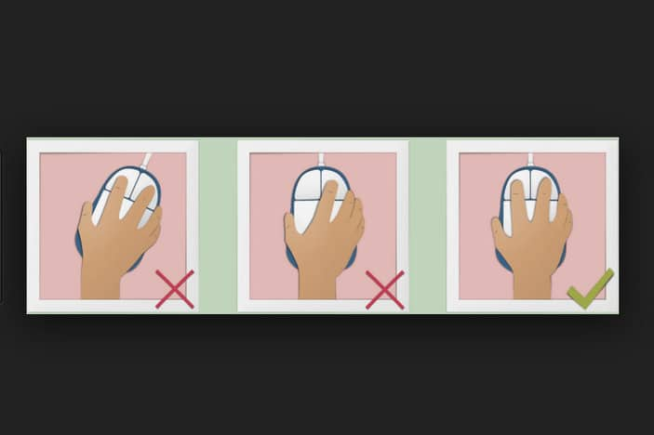
the CHROMEBOOK MOUSE or track Pad
How It Works

Slide 10
The Cursor
When moving the cursor, look at the screen rather than your hand.
To single click, use your index finger to press and release the left button.
To double-click, press the same button quickly twice, without removing your finger.
To drag an item, click on it and hold the button, then move the mouse.
To drop an item, drag it to the position you want, then release the mouse button.
Remember when using the mouse to keep your wrist straight and to move the mouse with your arm not your wrist, as demonstrated in this photo:

Slide 11
Mouse pad on the chromebook

Slide 12
Review

Slide 13
Questions

Slide 14
Survey
Please take a few minutes to fill out the presentation survey. The surveys help improve future presentations and events.
Thank You!
-Family Engagement & Education

