Slide 1
Tech for Parents Module 2
The Internet

Slide 2
Agenda
Review Chromebook Computer Basics
Internet Basics
Search Engines
Google Browser
Internet Dangers
Surfing the Net
Review
Questions
Materials Needed:
- Wi-Fi Enabled Device
- Pencil / Pen
- Paper

Slide 3
Computer Basics Parts of a Laptop
(3) Power Button
(6) [Track/Mouse] Pad
(2) [Left/Right] Clicker
(4) Screen
(5) Start Button
(1) ESC Key

Slide 4
Internet
The internet is a digital network connecting computers all over the world. There are a wide-range of uses for the internet. Some people use it to communicate and others use it to send pictures and movies.
We will be learning how to use “search engines” to get information, resources, and accessing the SUSD Family Engagement & Education webpage.

Slide 5
Internet Basics Different search engines

Slide 6
Internet basics
.com (commercial)
.org (organization)
.gov (government)
.biz (business)
.edu (education)
.mx (México)

Slide 7
Internet Basics the Google Browser
Tabs Bar
URL/Web Address Bar
Minimize
Maximize
Exit
Google Search Bar

Slide 8
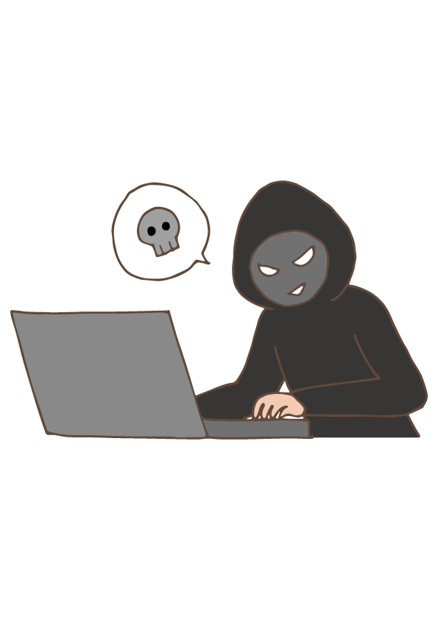
Internet Internet Dangers
Because the internet connects people all over the world there are inherent dangers to using the internet. Below we will discuss different dangers regarding online use.
“What is put online stays online”
Hackers/Phishers
Cyber Bullies
Viruses, Trojans, Malware, etc.

Slide 9
Internet surfing the net & SUSD homepage
Online Demonstration
Follow along on your screens to see your presenter surf the internet and help identify different sites, tools, and uses.
Please feel free to ask any questions about anything you see on screen or have heard and would like to hear more about.

Slide 10
Internet Exploring the susd homepage
Language Translation
Back Button
Navigating the Tabs
School Locator
Departments- FEEO
Students, Staff, Community
District Headlines
Calendar
Bottom of the Homepage

Slide 11
Review

Slide 12
Questions

Slide 13
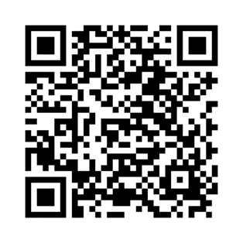
Survey
Please take a few minutes to fill out the presentation survey. The surveys help improve future presentations and events.
Thank You!
https://stocktonunified.co1.qualtrics.com/jfe/form/SV_8rjdOsdNXoMe8Fn
-Family Engagement & Education

Slide 14
Next Training
Tech for Parents Module 3
Date
Time
Place

