Slide 1
Tech for Parents Module 4
E-Mail

Slide 2
Agenda
Making Your Own Email
Identifying Your Email Account
Drafting an Email
Sending an Email
Attachments
Receiving an Email
Review
Questions
Survey
Materials Needed:
- Wi-Fi Enabled Device
- Pencil / Pen
- Paper

Slide 3
Making your own email Creating a Google account
Start by practicing your skills from the last Module. Navigate from Google’s search page to the account log-in (pictured below). Create a new account.

Slide 4
Making your own email Entering your account information
Fill in all the information they are asking for. When selecting your email address remember it will be public and everyone will be able to see what you choose. Select a password that is unique to you and that you will be able to easily remember.

Slide 5
Identifying your email account
Your email will have different “boxes” on the left corner that help keep your emails organized. When receiving or sending an email they will automatically be placed in a box and you can move them around using whatever system works best for you.
Click “Compose” to start a new email
This is a new email. Incoming emails will be displayed here
The boxes emails get separated into.
*User can create custom email boxes

Slide 6
Exploring your new email
Take a few minutes to explore your new email and click around! Write down questions you may want to ask at the end. We will talk about writing and sending an email shortly!

Slide 7
Drafting an email
Click the “Compose” button to start a new email. You will enter the email address of whomever you are emailing along with a subject line so they know what the email is about.
Compose Button
“To” line where the recipient’s email address is typed
“Subject” line where the emails title is written
Email body where the message is written
Press the “Send” button once you are done typing your email

Slide 8
Sending an Email
Just like a normal letter in the mail, you can add (attach) pictures, videos, weblinks, and other items to an email to send to someone.
To Line
Subject Line
CC Line
BCC Line
Email Body
Text Formatting
Send Button
Trash/Delete
Attachments

Slide 9
Sending an Email Definitions
Attachments – Multimedia that can be sent to other people (ex. pictures, videos, PDFs, etc.)
BCC (Blind Carbon-Copy) – Adding an email recipient that will be invisible to other recipients
CC (Carbon-Copy) – Sending a copy of the email to someone who is not the main recipient
Email Body – The main part of the email that has all the information and is written by the sender

Slide 10
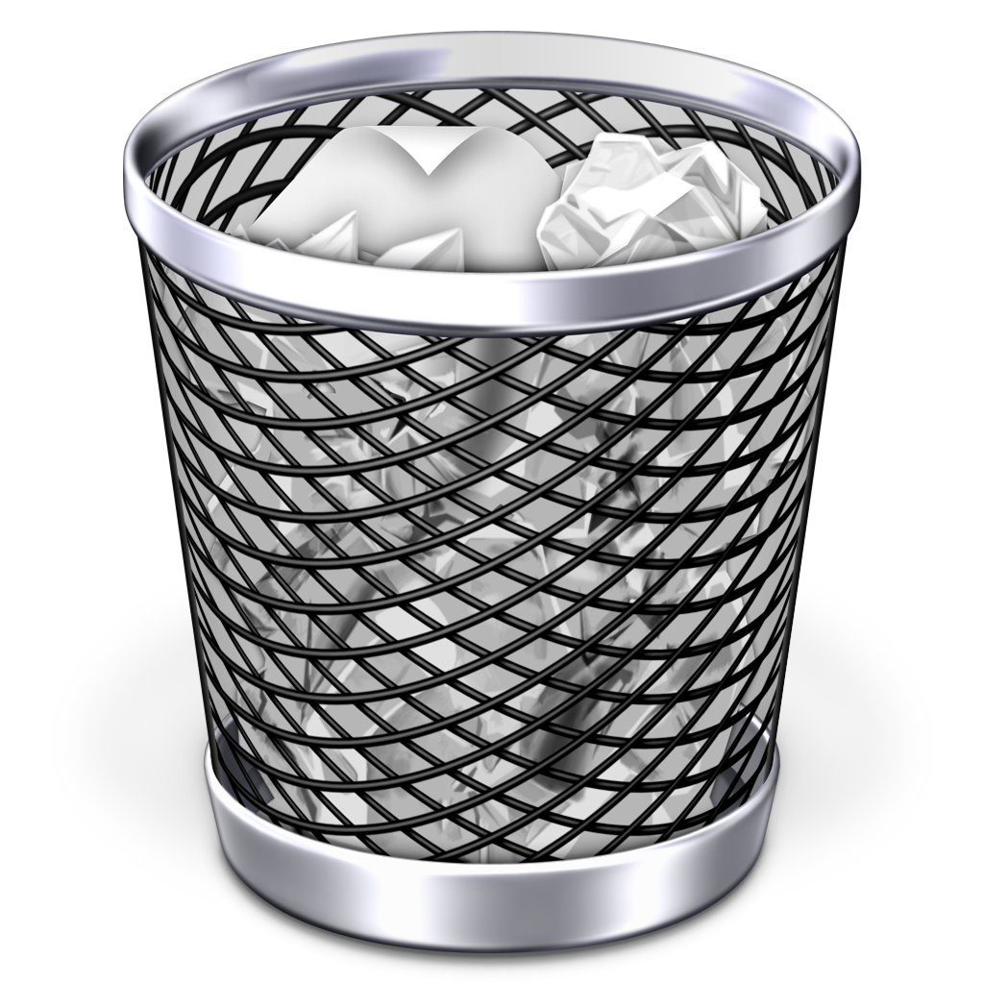
Sending an Email Definitions
Send Button – Press to send the completed email
Subject Line – The “Title” of the email so recipients know the contents of the email
Text Formatting – Options to change the color, font, size, etc. of the text in the email body
To Line – Write the email address(es) of who you would like to send the email to
Trash/Delete – Press to delete the current email being written (drafted)

Slide 11
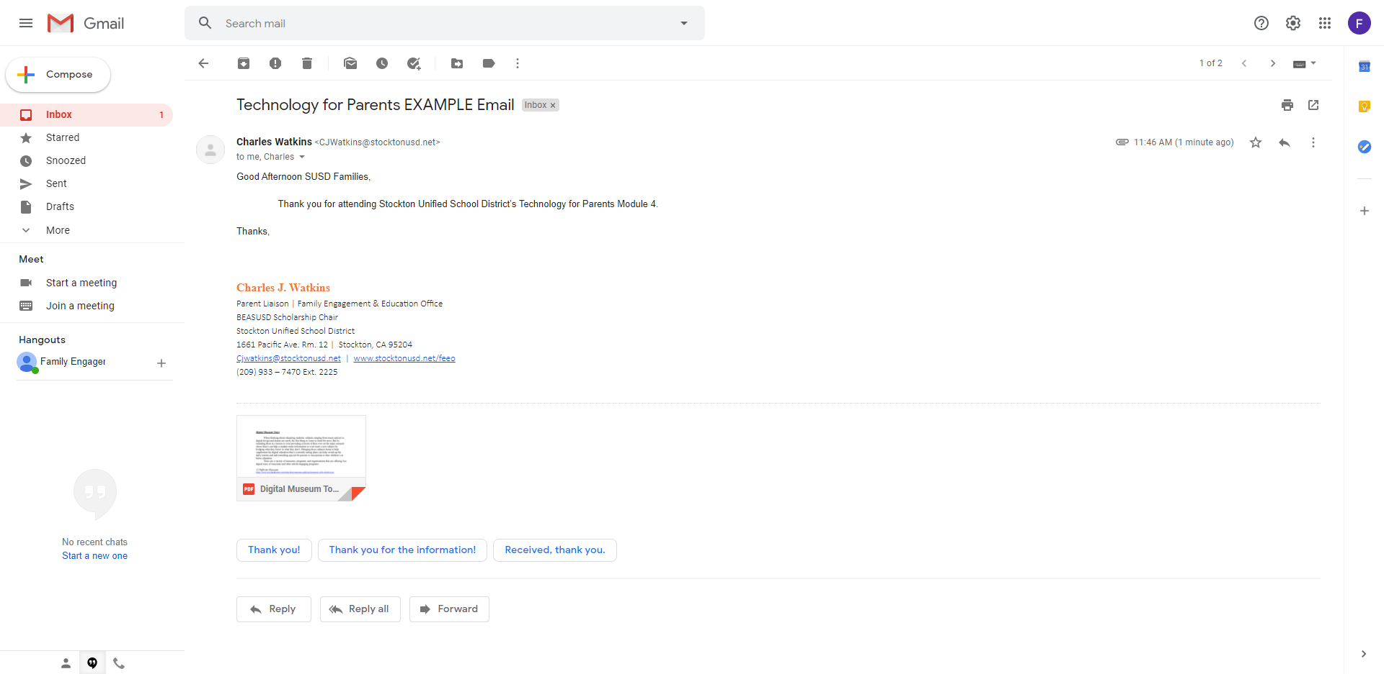
Receiving an Email
New email waiting in Inbox
Email Subject Line
Recipient Line
CC line
Date new email was received
Email Body
Email Attachments
-Reply
-Reply All
-Forward

Slide 12
Questions

Slide 13
Review

Slide 14
Survey
Please take a few minutes to fill out the presentation survey. The surveys help improve future presentations and events.
Thank You!
-Family Engagement & Education

