Slide 1
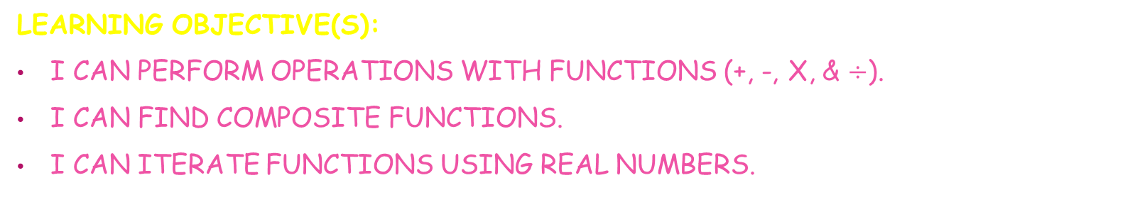
LESSON 1-2
COMPOSITION OF FUNCTIONS
Learning Objective(s):
I can perform operations with functions (+, -, x, & $÷$).
I can find composite functions.
I can iterate functions using real numbers.
ESSENTIAL QUESTION: How do I find the composition of functions?

Slide 2
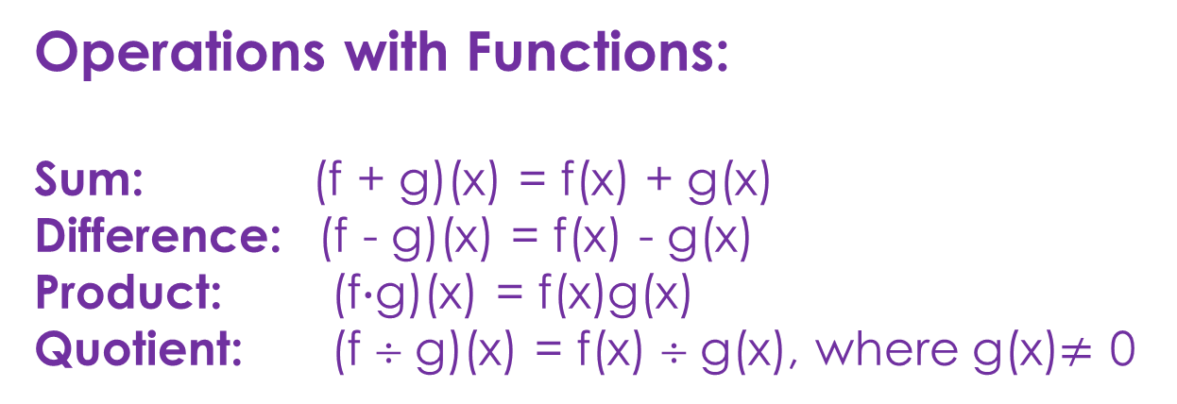
EX.1 – PERFORMING OPERATIONS WITH FUNCTIONS
Operations with Functions:
Sum: (f + g)(x) = f(x) + g(x)
Difference: (f - g)(x) = f(x) - g(x)
Product: (f$∙$g)(x) = f(x)g(x)
Quotient: (f ÷ g)(x) = f(x) ÷ g(x), where g(x)$≠$ 0

Slide 3
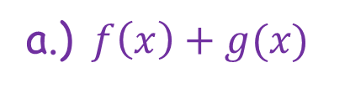
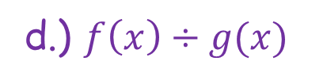
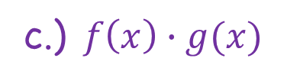
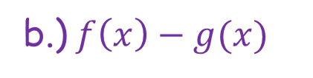
EX.1 – PERFORMING OPERATIONS WITH FUNCTIONS
I/WE DO:
$Given f\left(x\right)=3x^{2}−4 and g\left(x\right)=4x+5, Find each function.$
a.)$f\left(x\right)+g(x)$
b.)$f\left(x\right)−g(x)$
c.)$f\left(x\right)∙g(x)$
d.) $f\left(x\right)÷g(x)$

Slide 4
EX.1 – PERFORMING OPERATIONS WITH FUNCTIONS
I/WE DO:
$Given f\left(x\right)=5x^{2}+1 and g\left(x\right)=2x+5, Find each function.$
a.)$f\left(x\right)+g(x)$
b.)$f\left(x\right)−g(x)$
c.)$f\left(x\right)∙g(x)$
d.) $f\left(x\right)÷g(x)$

Slide 5
EX.1 – PERFORMING OPERATIONS WITH FUNCTIONS
YOU DO:
$Given f\left(x\right)=2x−1 and g\left(x\right)=x^{2}, Find each function.$
a.)$f\left(x\right)+g(x)$
b.)$f\left(x\right)−g(x)$
c.)$f\left(x\right)∙g(x)$
d.) $f\left(x\right)÷g(x)$

Slide 6

EX.2 – FINDING THE COMPOSITION OF FUNCTIONS
Composition of Functions:
Given functions f and g, the composite function (f $°$ g) can be described by the following equation:
The domain of includes all of the elements of x in the domain of g for which g(x) is in the domain of f.

Slide 7
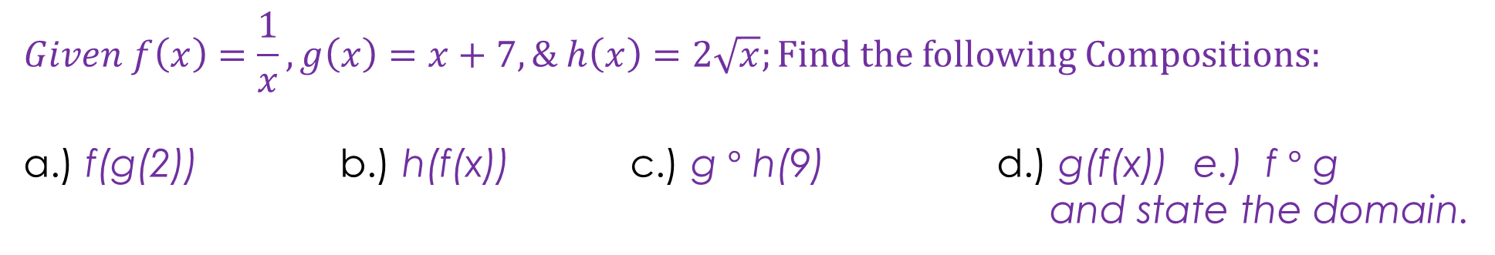
EX.2 – FINDING THE COMPOSITION OF FUNCTIONS
I/WE DO:
$$Given f\left(x\right)=\frac{1}{x}, g\left(x\right)=x+7, \& h\left(x\right)=2\sqrt{x};Find the following Compositions:$$
a.) f(g(2)) b.) h(f(x)) c.) g $°$ h(9) d.) g(f(x)) e.) f $°$ g
and state the domain.

Slide 8
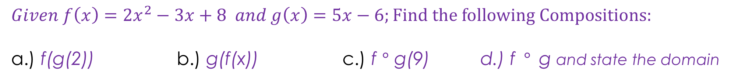
EX.2 – FINDING THE COMPOSITION OF FUNCTIONS
YOU DO:
$$Given f\left(x\right)={2x}^{2}−3x+8 and g\left(x\right)=5x−6;Find the following Compositions:$$
a.) f(g(2)) b.) g(f(x)) c.) f $°$ g(9) d.) f$°$g and state the domain

Slide 9
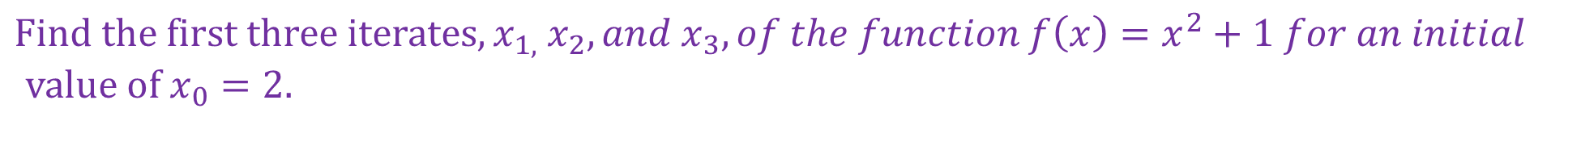
EX.3 – FINDING ITERATIONS OF A FUNCTION
I/WE DO:
$$Find the first three iterates, x_{1, } x_{2}, {and x}_{3}, of the function f\left(x\right)=x^{2}+1 for an initial$$
$value of x_{0}=2.$

Slide 10
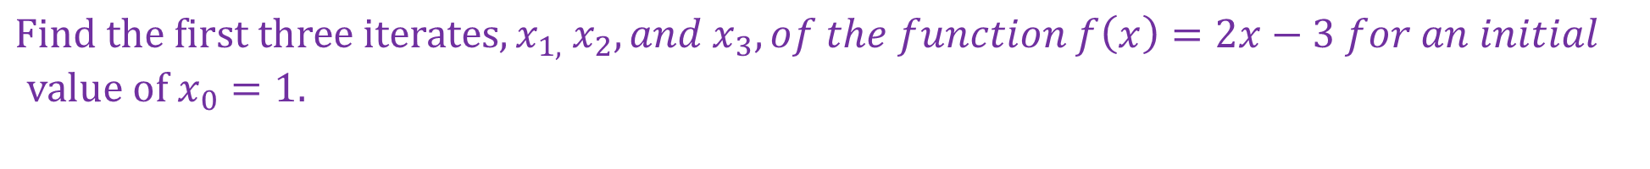
EX.3 – FINDING ITERATIONS OF A FUNCTION
YOU DO:
$$Find the first three iterates, x_{1, } x_{2}, {and x}_{3}, of the function f\left(x\right)=2x−3 for an initial$$
$value of x_{0}=1.$

