Slide 1
1-1 Properties of Real Numbers
Learning Objective:
I Can Graph and Order Real Numbers.
I Can Identify and Use properties of Real Numbers.
Essential Question: What is the difference between a Rational & Irrational Number?

Slide 2

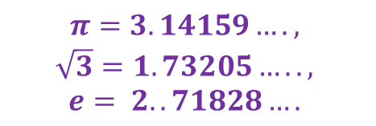

VOCABULARY
Real Numbers are the set of numbers that can be plotted on a number line.
Rational Numbers are the set of numbers that can be expressed as a fraction of two integers.
Irrational Numbers are the set of numbers that can be expressed as non-terminating and non-repeating decimals.
Vocab. Word/Term
Definition/Category/Descriptors
Example
Real Numbers
-Set
Of numbers
That can be plotted on a number line.
5, -8, 2.5, $\frac{3}{4},\sqrt{49}$
Rational Numbers
-Set
Of numbers
That can be expressed
As a fraction of two integers
Can Also Be repeating and terminating decimals
5, -8, 2.5, $\frac{3}{4},0.7$
Irrational Numbers
-Set
Of numbers
that can be expressed
As non-terminating and non-repeating decimals
Cannot be written as a fraction
$$π=3.14159….,$$
$$\sqrt{3}=1.73205…..,$$
$$e= 2..71828….$$

Slide 3



VOCABULARY
Natural Numbers are the set of whole numbers used for counting; zero is excluded.
Whole Numbers are the set of natural numbers and zero.
Integers are the set of natural numbers (also called positive numbers) and their opposites(also called negative numbers), and zero.
Vocab. Word/Term
Definition/Category/Descriptors
Example
Natural Numbers
-Set
Of numbers
Whole
Excluding Zero
Counting.
1, 2, 3,4$,5,…..$
Whole Numbers
-Set
Of natural numbers
Including Zero
0, 1, 2,3$,4,…..$
-Set
Of natural numbers
And their opposites
Including zero
Integers
$$….−3,−2,−1,0,1,2,3,…,$$

Slide 4



VOCABULARY
Absolute Value – The Absolute Value of a real number is its distance from zero on the number line. Distance can never be negative. The symbol for absolute value is $\left|x\right|.$
Vocab. Word/Term
Definition/Category/Descriptors
Example
Absolute Value
-Distance
From Zero
On the number line
Can never be negative
Symbol is $\left|x\right|$
$$\left|5\right|=5$$
$\left|−5\right|=$5

Slide 5
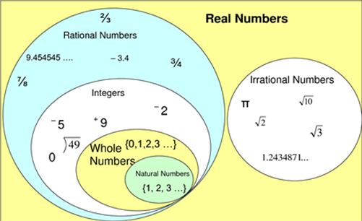
Ex.1 – Identifying Real Numbers

Slide 6

Ex.1 – Identifying Real Numbers Cont’d
Name the set(s) of numbers to which each number belongs.
$\frac{1}{4}$ b) $0.\overline{6}$ c) $\sqrt{25}$
d) $−\frac{28}{7}$ e) 8 f) $\sqrt{7}$

Slide 7
SHORT SUMMARY #1
To ______________ which _____________ of numbers that each _____________ belongs; first I

Slide 8
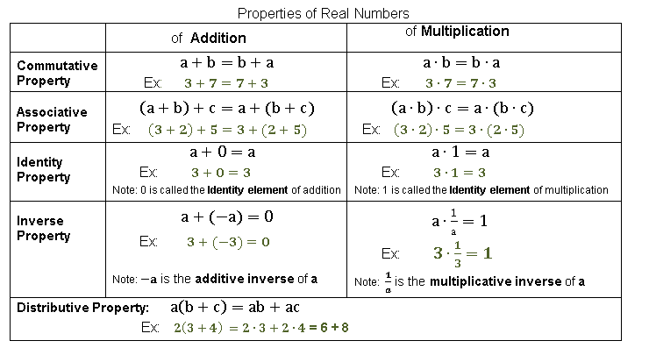
EX.2 – IDENTIFYING PROPERTIES OF REAL NUMBERS

Slide 9
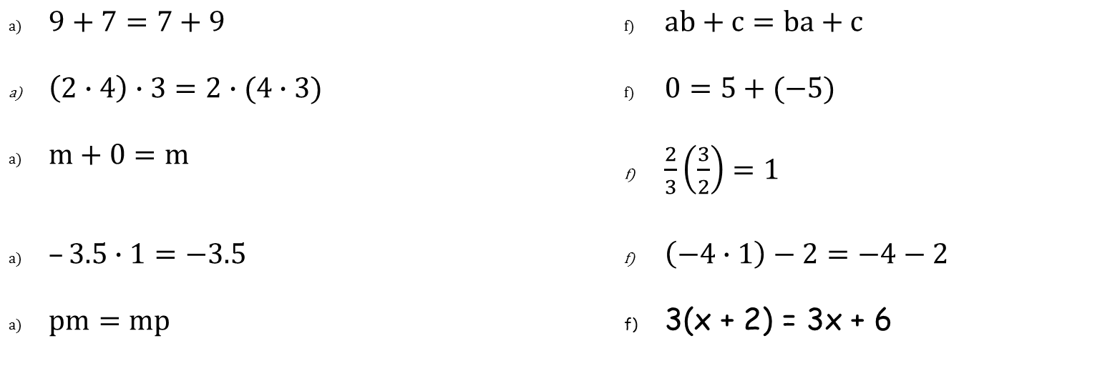
EX.2 – IDENTIFYING PROPERTIES OF REAL NUMBERS CONT’D
Identify the property.
$9+7=7+9$ | $ab+c=ba+c$
$\left(2∙4\right)∙3=2∙(4∙3)$ | $0=5+(−5)$
$m+0=m$ | $\frac{2}{3}\left(\frac{3}{2}\right)=1$
$–3.5∙1=−3.5$ | $\left(−4∙1\right)−2=−4−2$
$pm=mp$ | 3(x + 2) = 3x + 6

Slide 10
SHORT SUMMARY #2
To Identify a property I,

Slide 11

EX. 3- Graphing Numbers on the Number Line
The Opposite or Additive Inverse of any number a is –a. The sum of a pair of opposites is zero.
The Reciprocal or Multiplicative Inverse of any nonzero number a is $\frac{1}{a}.$ The product of a pair of reciprocals is 1.

Slide 12

EX. 3- Graphing Numbers on the Number Line Cont’d
Use the number line below to plot the following numbers
a) 1/2 b) √4 c) -√9 d) √5 e) opposite of 4 f) reciprocal of (- 7/2)

Slide 13
SHORT SUMMARY #3

Slide 14
EX. 4- Finding Absolute Value
Find the absolute value.
| 5 | b) |-5 | c) |-1∙ 7 |
d) |-9/14 | e) 4+|- 5 | f) -|- 10-(-1)|

Slide 15
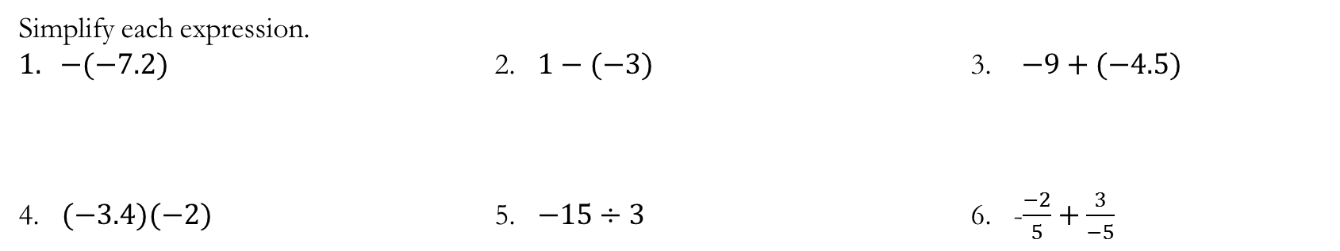
WARM-UP
Simplify each expression.
$1. −(−7.2)$ 2. $1−(−3)$ 3. $−9+(−4.5)$
4. $(−3.4)(−2)$ 5. $−15÷3$ 6. -$\frac{−2}{5}+\frac{3}{−5}$

Slide 16
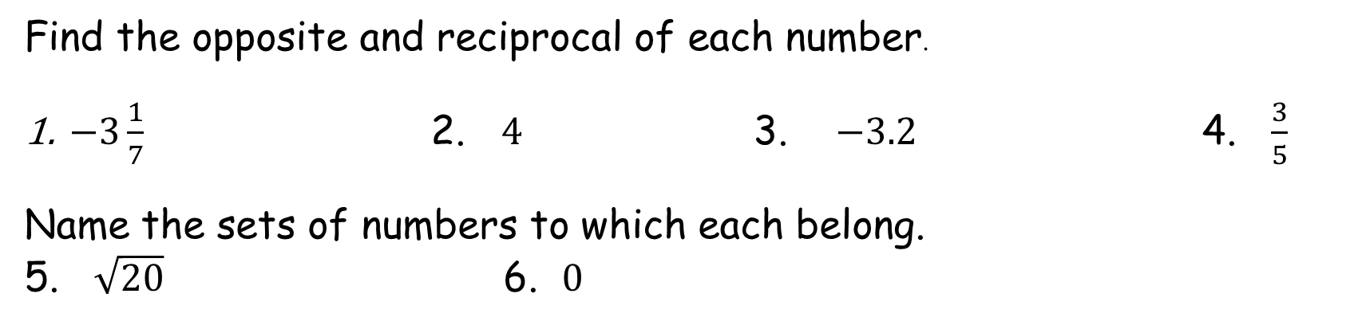
WARM-UP
Find the opposite and reciprocal of each number.
$−3\frac{1}{7}$ 2. $4$ 3. $−3.2$ 4. $\frac{3}{5}$
Name the sets of numbers to which each belong.
5. $\sqrt{20}$ 6. $0$

